Slide 1
Type of Inheritance
Week 05
25 October, 2022

Slide 2
Type of Inheritance
Single Inheritance
Multiple Inheritance
Multi-Level Inheritance
Hierarchal inheritance
Hybrid Inheritance

Slide 3
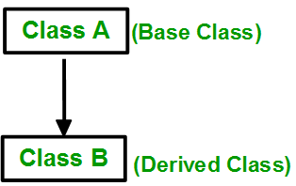
Single Inheritance
Single Inheritance: In single inheritance, a class is allowed to inherit from only one class. i.e. one subclass is inherited by one base class only.

Slide 4

Multiple Inheritance:
Multiple Inheritance: Multiple Inheritance is a feature of C++ where a class can inherit from more than one class. i.e one subclass is inherited from more than one base class.

Slide 5
Multiple Inheritance
Syntax:
class subclass_name : access_mode base_class1, access_mode base_class2, ....
{
// body of subclass
};

Slide 6
Multiple Inheritance(Example)
class B
{
... .. ...
};
class C
{
... .. ...
};
class A: public B, public C
{
... ... ...
};

Slide 7
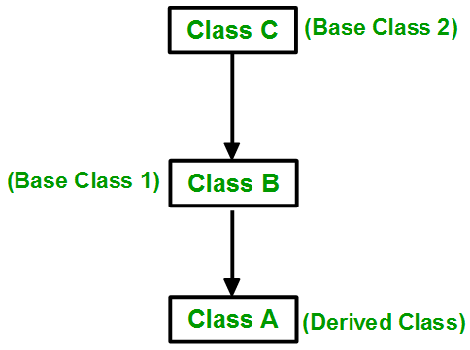
Multilevel Inheritance
Multilevel Inheritance: In this type of inheritance, a derived class is created from another derived class.

Slide 8
Multilevel Inheritance
Syntax:-
class C
{
... .. ...
};
class B:public C
{
... .. ...
};
class A: public B
{
... ... ...
};

Slide 9
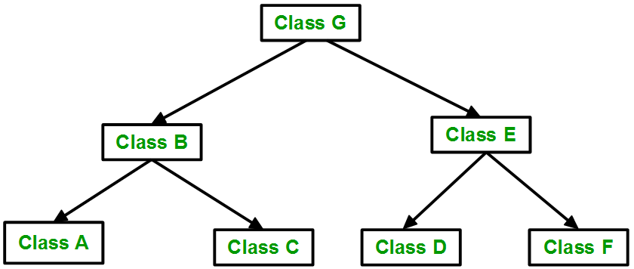
Hierarchical Inheritance:
In this type of inheritance, more than one subclass is inherited from a single base class. i.e. more than one derived class is created from a single base class.

Slide 10
Hierarchical Inheritance:
Syntax:
class A
{
// body of the class A.
}
class B : public A
{
// body of class B.
}
class C : public A
{
// body of class C.
}
class D : public A
{
// body of class D.
}

Slide 11
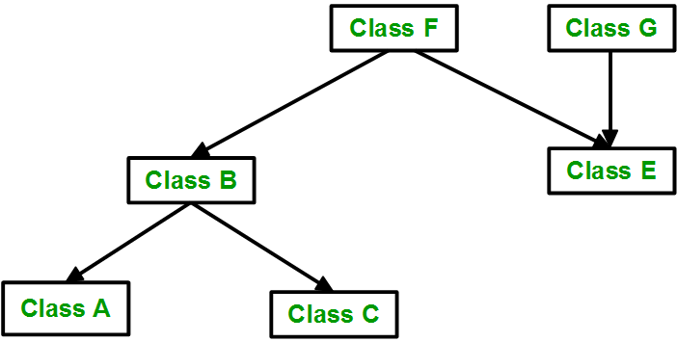
Hybrid (Virtual) Inheritance:
Hybrid Inheritance is implemented by combining more than one type of inheritance. For example: Combining Hierarchical inheritance and Multiple Inheritance.
Below image shows the combination of hierarchical and multiple inheritances:

